Slide 1







Caring for the Carers
Compiled by Mr. Blessing Gumbu on behalf of the Transformation Committee
What our community told us about caregiving in academia
Insights from a live interactive session with 56 participants from the academic and research community at SANS Conference 2026

Slide 2





How the
room engaged
Engagement by question
Question 1
what caregiving means
89%
56 participants shared 153 contributions
Question 2
trepidations
32%
57%
43%
Question 3
how to support caregivers
11%
87 responses
66 reactions
Participation fell as questions
became more personal and practical.

Slide 3
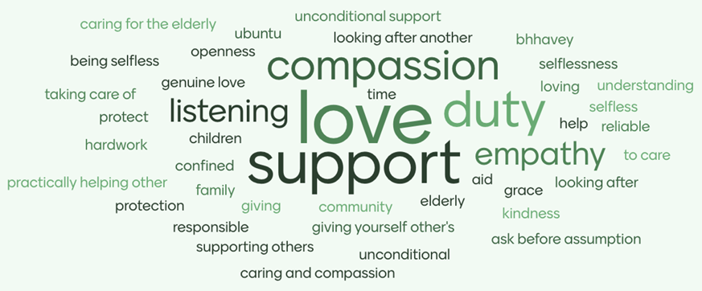
What does caregiving mean to you?
empathy
support
grace
love
community
ubuntu
50 of 56 participants gave 64 responses

Slide 4







Love and duty side by side
Participants describe caregiving as an act of love and support.
Things to do
- meeting
- emails
- groceries
- call Mum
Alongside that warmth,
words like duty, responsible, hard work and confined
reveal the weight it carries.
Pick up kids
from school

Slide 5








Our
trepidations
18 participants shared their fears about caregiving. Their concerns fall into a few key themes.
01
burnout and emotional drain
02
guilt and fear of not doing enough
03
losing parts of myself and fearing
my capacity will not be the same again
04
responsibility beyond capacity
05
grief and attachment
06
security, from finances to support
in the workplace

Slide 6












Anonymous participant voices
It feels like
it doesn’t end.
Enforcing
boundaries when
capacity is limited.
Burning out,
missing out on
my life goals…
You get torn between the love of the person and your passion,
so you try to do both.
External people
not understanding
the scope of the consequences.

Slide 7






Structural
and systemic barriers
The systems around
academic caregivers.
Maternity and paternity leave
Supporting
caregivers
in academia
Grant timelines: ERC and Wellcome Trust vs NRF
Is disability recognised?
Family responsibility leave
Leaky pipeline: why do women leave academia more than men?
Which women are most likely to leave?

Slide 8



How we can support caregivers
Plan ahead. Provide clear guides for growing families, since HR hasn’t.
Lead with empathy. Avoid assumptions — there’s more to someone’s day than we see.
Listen first. Hear their stories so we understand what they truly need.
Show up. Be supportive and responsive in everyday interactions.
Remove barriers. Offer childcare at conferences, even if paid, for peace of mind.

Slide 9


What
caregivers need
Support that is personal, practical, and people-first.
Empathy and listening that understand their reality
Guidance that is tailored, clear, and easy to access
Practical help at work and with childcare
Care for caregivers, so they can keep caring

